Slide 1
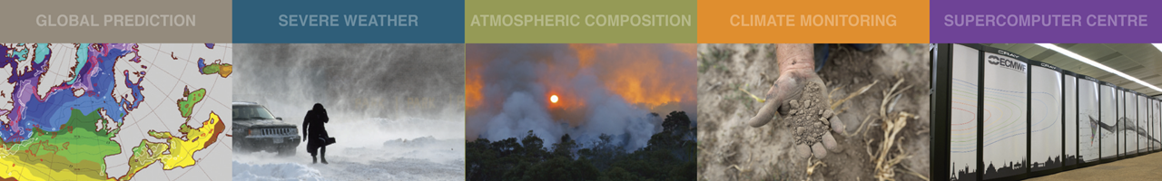
ECMWF Status Report (1)
GODEX November 2018
Lars Isaksen and Ioannis Mallas
ECMWF
Lars.Isaksen@ecmwf.int
Ioannis.Mallas@ecmwf.int
Acknowledgements to: Alan Geer, Bruce Ingleby, Chris Burrows, Giovanna De Chiara, Katie Lean, Kirsti Salonen, Marco Matricardi, Mike Rennie, Niels Bormann, Peter Lean, Reima Eresmaa, Sean Healy, Stephen English and Tony McNally

Slide 2
Outline
Highlights of recent and forthcoming IFS upgrades
  11 July 2017 (CY43R3) - improved humidity analysis (see 1st GODEX meeting)
  5 June 2018 (CY45R1) - Ocean coupling to the HRES forecast
  March 2019 (CY46R1) - Continuous DA and use of more observations
Other recent results regarding use of observations for NWP at ECMWF
Some specific GODEX requests from ECMWF staff
Part 2 of ECMWF status report later this afternoon:
Data reception, observation issues, BUFR migration, snow, WIGOS … – Ioannis Mallas

Slide 3
5 June 2018 (CY45R1) – Highlights
An increased number of observations is assimilated (Infrared data over land, all-sky microwave over coastlines)
Ocean and sea-ice models coupled in HRES forecast (now consistent with ENS/SEAS5 setup)
Radiosondes drift and improved aircraft obs temperature bias correction
Atmospheric model changes (warm-rain, convection)
The model uncertainty SPPT scheme simulation becomes more ‘physical’, and the SKEB deactivation brings 2.5% cost savings
Changes to SPPT makes the EDA more reliable and consistent with ENS setup
A new product, lightning and probability of lightning, made available
Operational production is ~15% faster due to optimizations
Impact on scores: positive over the tropics, neutral over extra-tropics

Slide 4
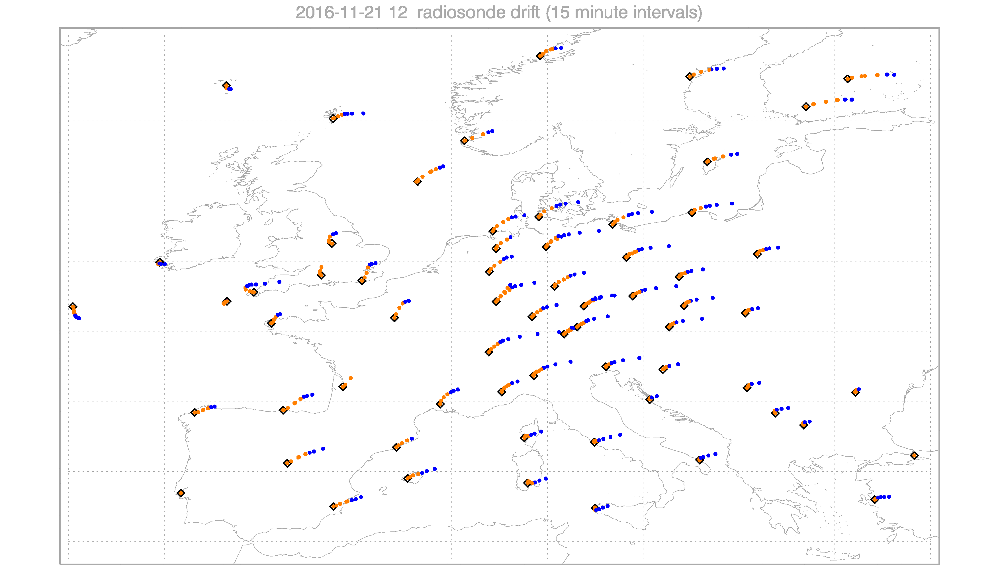
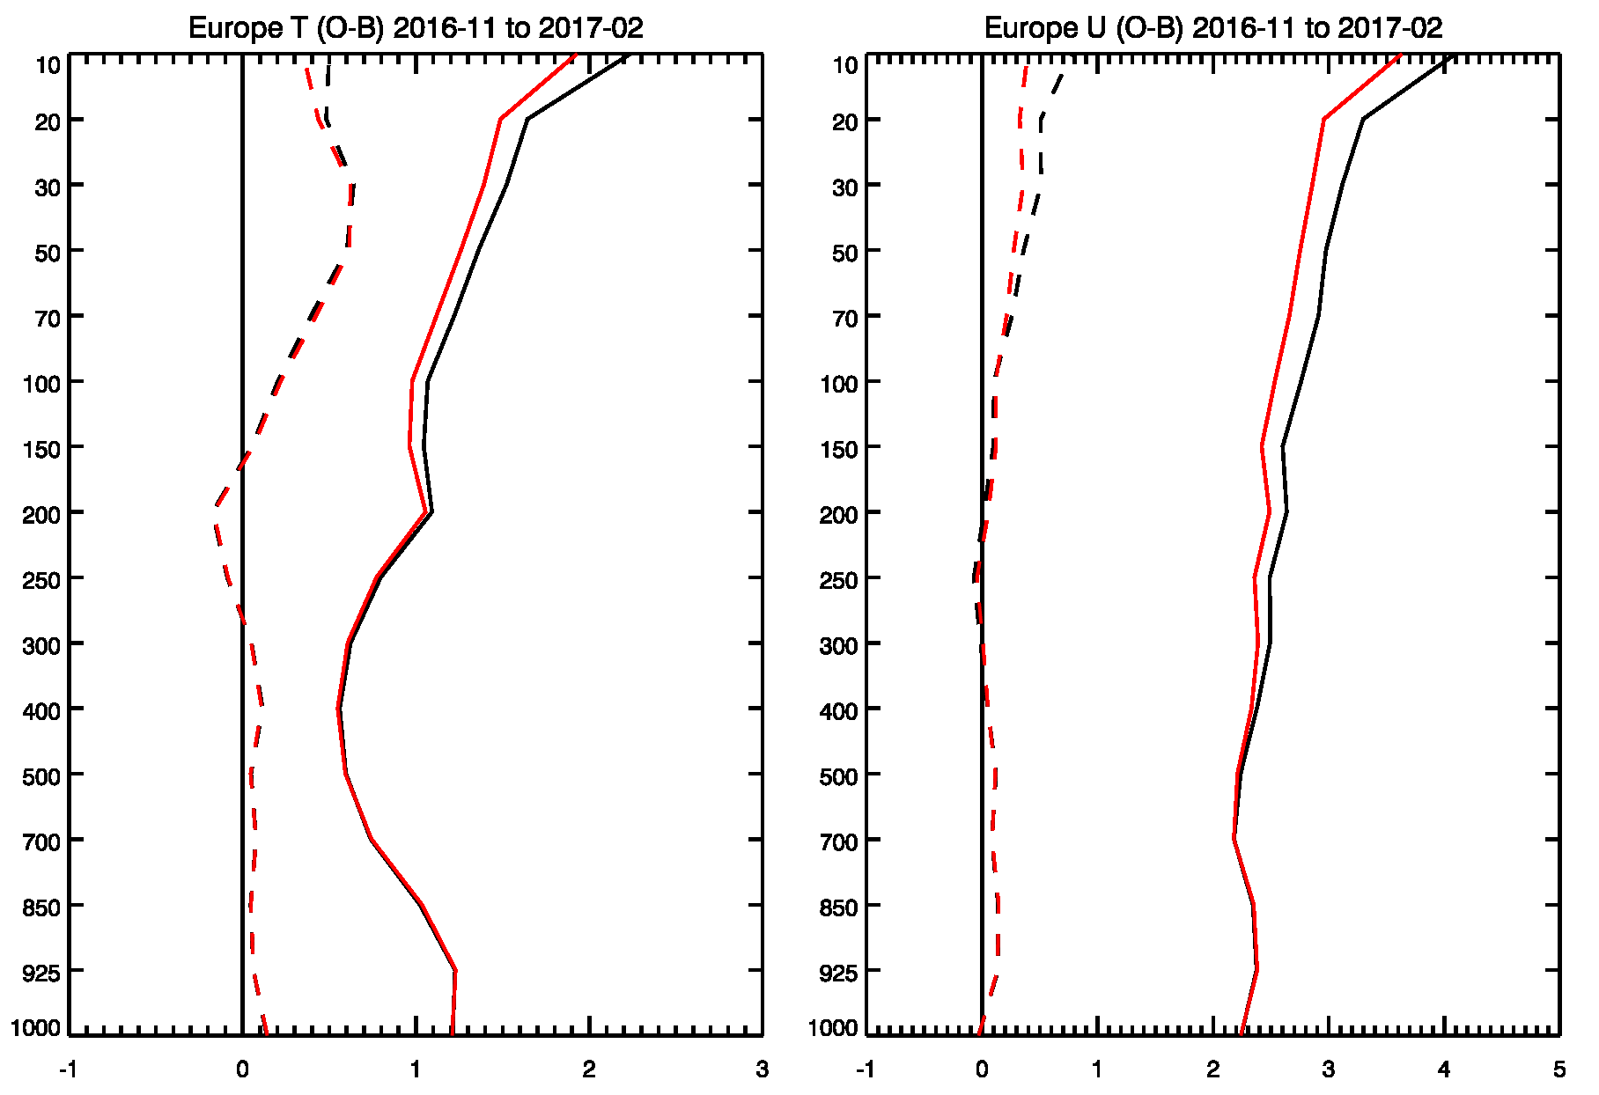
In 45r1 radiosonde drift is taken into account
For radiosondes reporting their position at each level in BUFR the horizontal drift is taken into account in the observation operator. This enables more accurate computation of innovations (by the time the radiosondes reach the stratosphere it is not uncommon to have drifted more than 300km from the launch position). This improves the analysis of temperature and wind, mostly at altitudes above 400 hPa
RAOB O-B departures, Europe, Nov. 2016 – Feb. 2017
320km

Slide 5
Operational changes related to in situ observations during the last year
Nov 2017: LATAM aircraft data from South America started
Jan 2018: stopped assimilating AIREP temperatures (largely ~duplicate now)
May 2018: blacklist winds from B787 aircraft
June 2018 45r1: treatment of radiosonde drift for BUFR reports
  Revised σ_{o} for radiosonde temperatures
  Radiosonde T/RH bias correction: use RS41/RS92 as reference
Jul 2018: added HiRes Japanese radiosonde data (late 2017 US data)
Aug 2018: rejected Indian radiosonde winds at 900/800/600 hPa
Sep 2018: checking new aircraft reports from Australia/PNG and extra Synop data from Brazil
Some feedback to data producers, eg wrong heights in Chilean BUFR SYNOP reports – now fixed

Slide 6
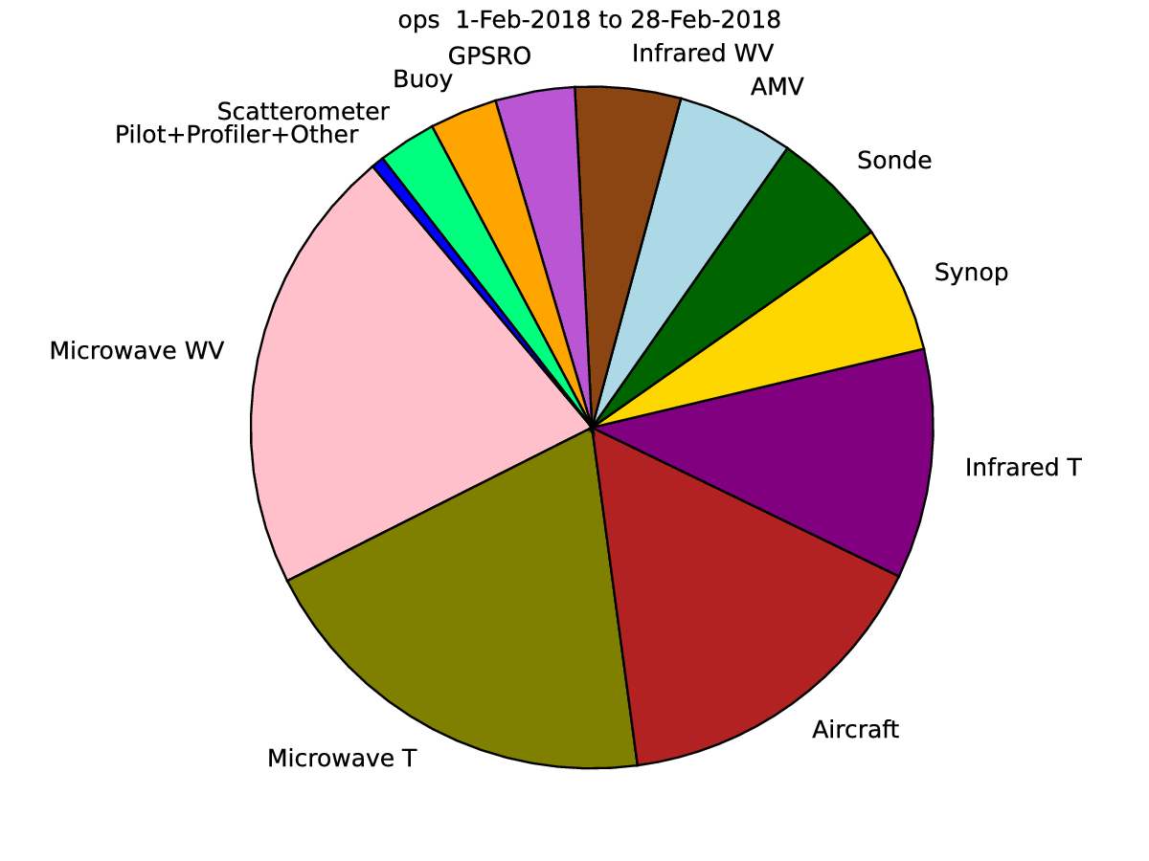
ECMWF FSOI February 2018:
70% of 24h forecast impact comes from satellite data
30% of 24h forecast impact comes from in situ data
Adapted from Alan Geer’s ECMWF Annual Seminar 2018 talk

Slide 7
Cycle 46r1 (planned for March 2019) main content
Contributions are expected in many areas, including:
Continuous DA
50 member EDA
OOPS contributions
Upgraded use of observations (surface pressure bias-correction, use of new OSTIA product, ..)
Land Surface assimilation using 50-member EDA Jacobians
Wave model physics improvements; ocean model upgrade (NEMO 3.6)
Atmospheric model changes: convection, radiation, new snow scheme, changes to allow more testing of single-precision, aerosols (full 3D climatology and revised optical properties)
ENS radiation time step from 3 to 1 hour; initial perturbations’ re-tuning following EDA upgrade

Slide 8
The time critical path
Continuous Data Assimilation
By the time the analysis is complete,
the most recent observations are almost 2 hours old
Early Delivery example:
Users expect all products are available
cut-off time
Product generation
Screening +
4D-Var
Forecast
buffer
30min
21z
6 hr assimilation window
03z
04z
05z
06z
06:55z
Time critical path
Notes:
Most recent obs is 4 hours old by the time users have access to the forecast
Just concerned with data assimilation here… roughly 1 hour.
What is the value of 1 hour of observations?

Slide 9
46r1 implementation plan
Continuous Data Assimilation
Present critical path
04:00z
New critical path
03:40z
04:25z
SAPP
get
SAPP
get
SAPP
get
SAPP
get
COPE filters
COPE filters
COPE filters
COPE filters
BUFR pre-screening
b2o
BUFR pre-screening
b2o
BUFR pre-screening
b2o
BUFR pre-screening
b2o
traj_0
screen
4D-Var
Min0
traj_1
screen
4D-Var
Min1
traj_2
screen
4D-Var
Min2
traj_3
screen
4D-Var
Min3
Notes:
46r1 implementation is more complicated than it will be under COPE

Slide 10
Continuous DA at 46r1:
Continuous Data Assimilation
New observations added in each outer loop = 25 minute later cut-off
  involves “re-screening” the observations in each trajectory
8 hour assimilation window (Early Delivery, previously 6 hours)
  Ensures all observations that have arrived can be assimilated
iii. Start assimilation earlier = allows 4 outer loops
17% more observations used
Continuous DA enables more expensive DA by starting analysis earlier
Notes:
Team effort

Slide 11
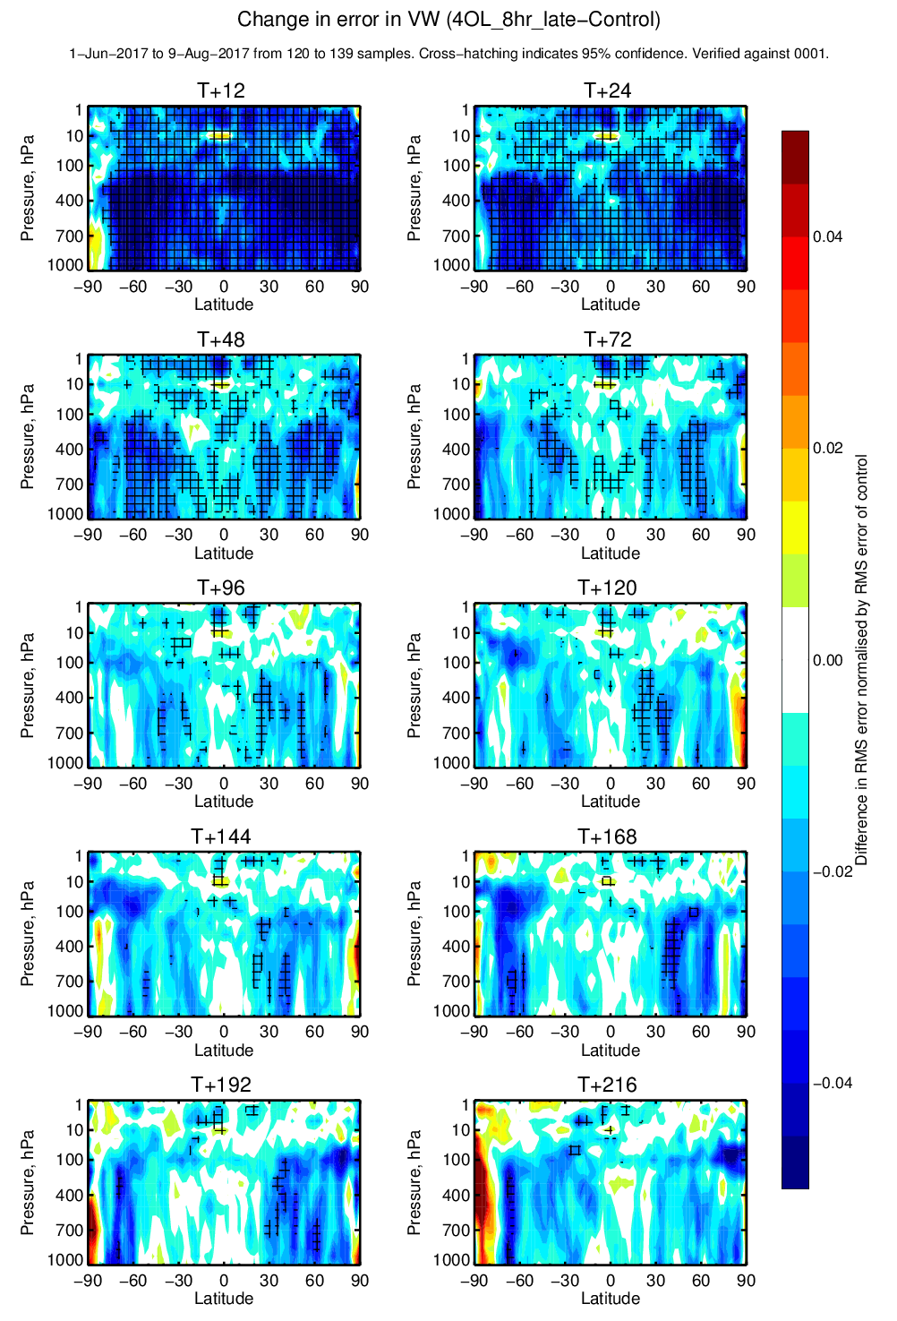
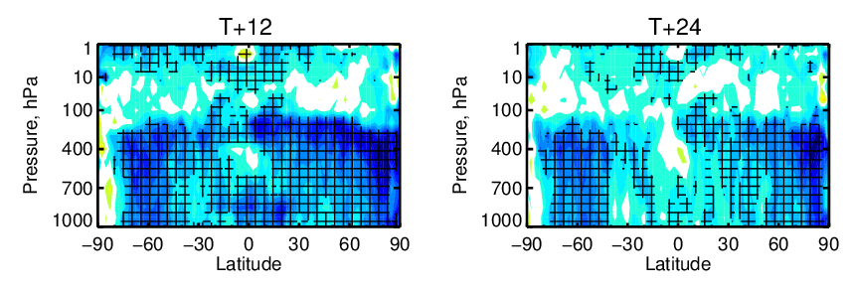
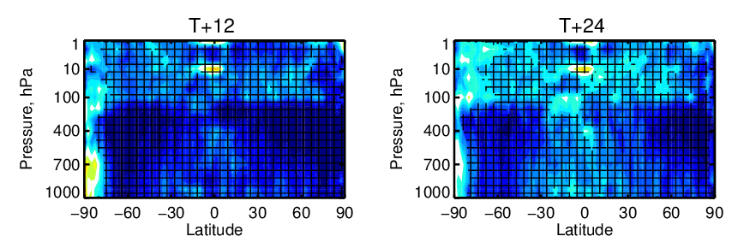
Continuous Data Assimilation
Of this new-found freedom to explore and use operationally better performing 4D-Var configurations, only the increase in # of outer loops has been exploited so far (IFS CY46R1)
Vector wind RMS error
(bad)
+0.04 relative RMS error change
Impact of additional observations in Cont. DA
Additional observations
+ 4 outer loops
-0.04 relative RMS error change
(good)

Slide 12

EUMETSAT ROM SAF collaboration with CMA for GNOS RO measurements leads to data improvements
ROM SAF ROPP code is used to processes the operational CMA GNOS bending angles.
ROM SAF VS activity supported Mi Liao to visit ECMWF in 2017 to improve the GNOS processing. Collaboration successful leading to improved CMA GNOS data.
FY-3C assimilated operationally at ECMWF since March 2018.
  Also now in DWD/Met Office.
Mi Liao has provided 4 days (May 2-5, 2018) of FY-3D data and they have been tested in the NWP system. Larger FY-3D noise above 30 km.
Problem identified and improved GNOS data processing. 2nd FY-3D dataset, July 2-5, 2018.

Slide 13
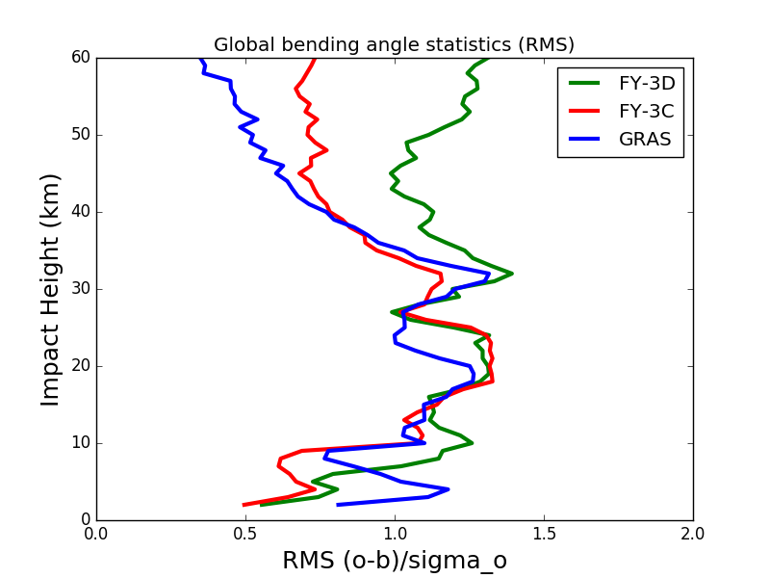
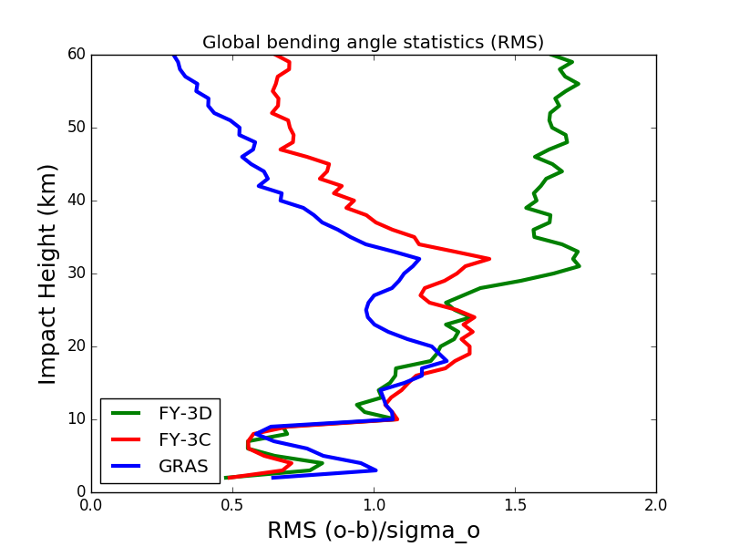
FY-3D global RMS bending angle departure statistics (May 2-5, 2018)
SET
RISING

Slide 14
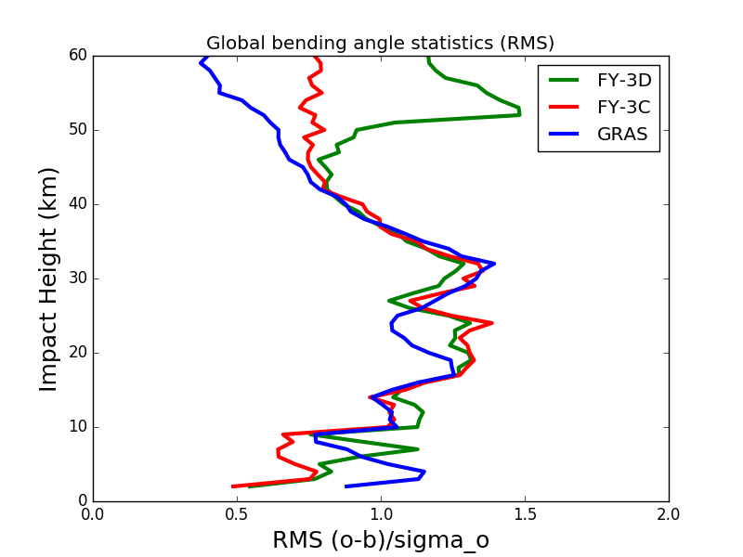
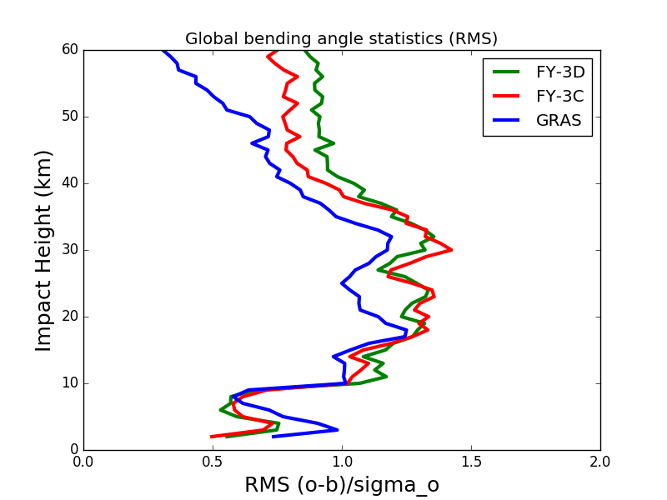
FY-3D global RMS bending angle departure statistics (July 2-5, 2018)
SET
RISING

Slide 15
How do we increase the impact of IR data ?
Add NOAA-20 CrIS
Access more IR satellites in different orbital planes (Russia / China)
Exploit enhanced vertical resolution of IR via PCA
Maximise wind tracing of frequent GEO(/LEO) IR data (ahead of MTG)
Improve the handling of clouds / aerosols
Exploit AC (ozone/aerosol) information for NWP forecast model radiation

Slide 16
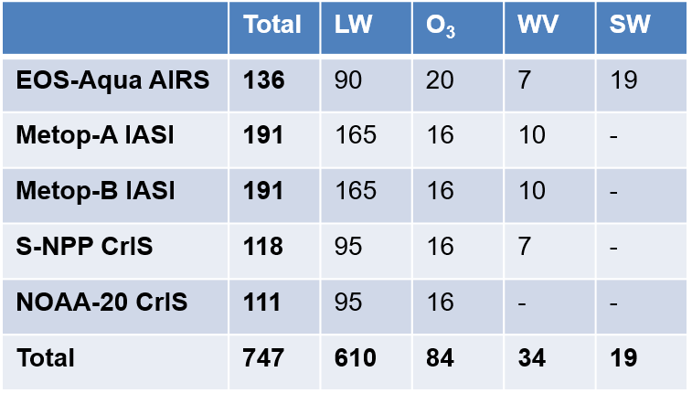
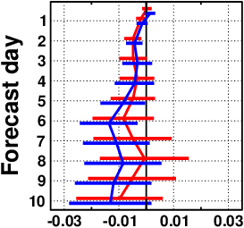
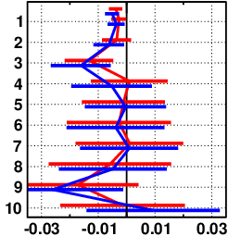
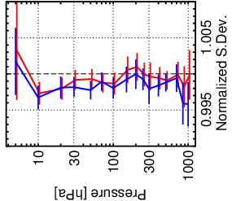
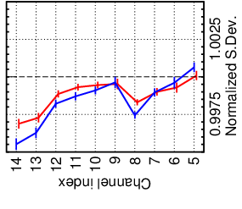
NOAA-20 CrIS is in operations
Active use of five hyperspectral sounders in operational system since 11/9/2018
Performance gain from NOAA-20 CrIS in forecast system diagnostics
Add S-NPP CrIS only
Add both S-NPP and NOAA-20 CrIS
Z500 RMSE N.Hem.
Z500 RMSE S.Hem.
TEMP+AIREP T
AMSU-A
☺
☺
☺
☺
Normalized BG fit

Slide 17

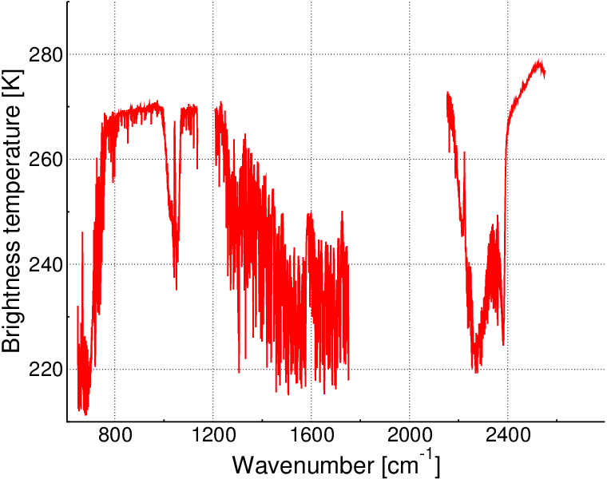
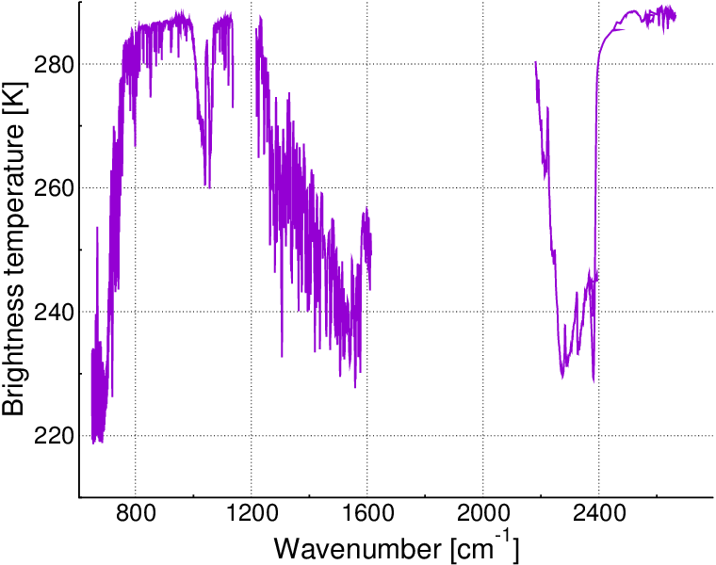
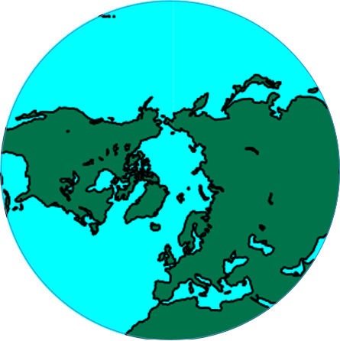
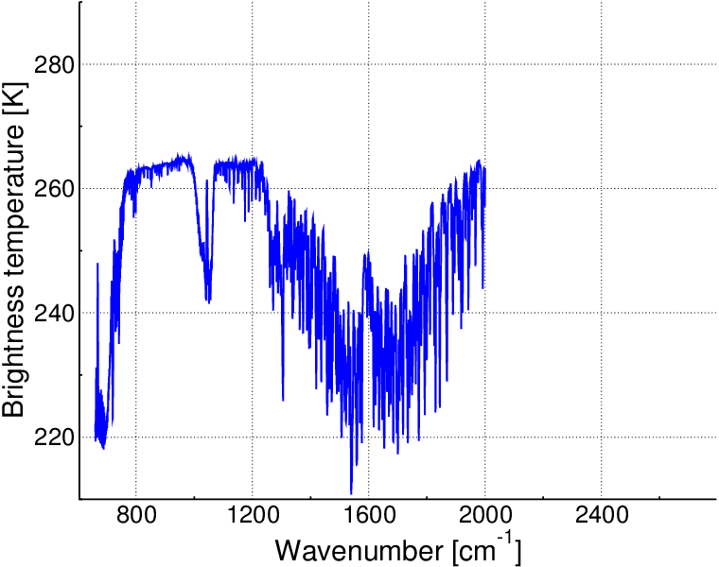
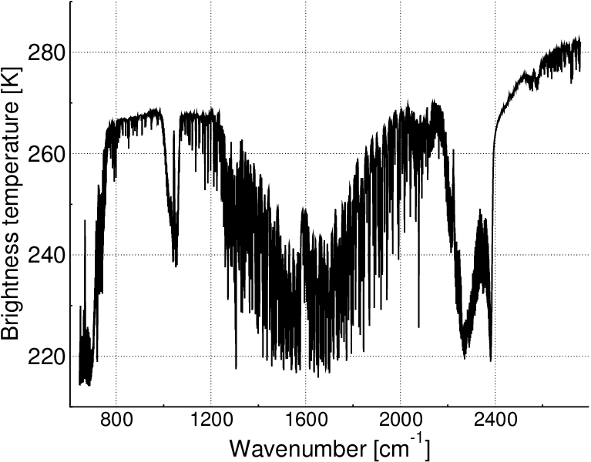
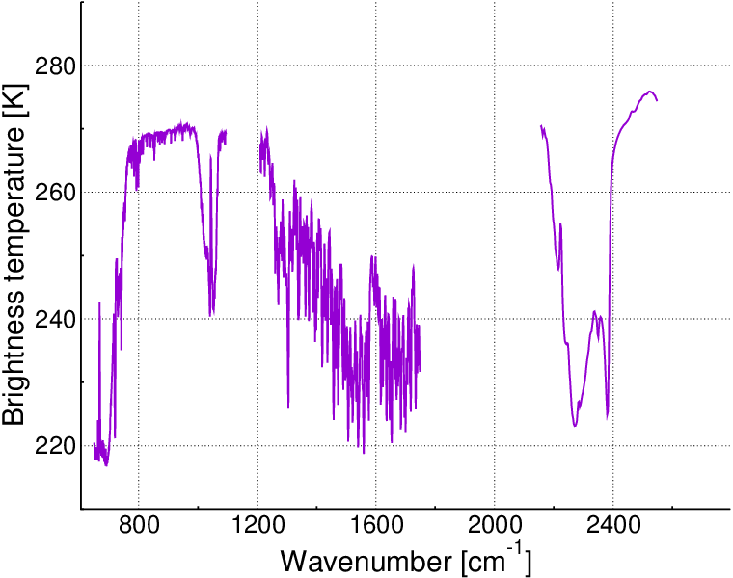
Eastern IR sounders are coming. We are ready.
HIRAS (China)
AIRS (U.S.A.)
2019 ?
03/2019 ?
IASI’s (Europe)
IKFS-2 (Russia)
CrIS’s (U.S.A.)

Slide 18
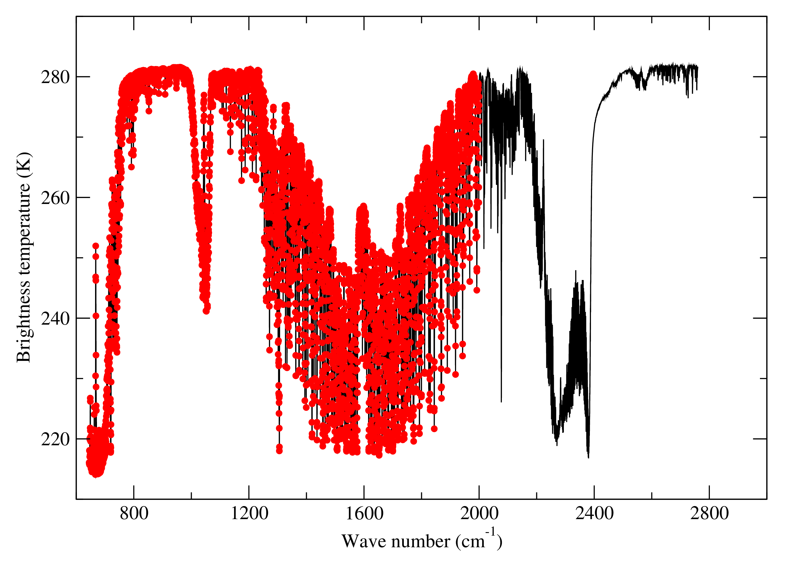
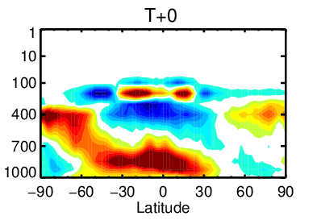
Exploiting the enhanced vertical resolution of IR
Assimilation of 400 RR = 5421 IASI channels
Assimilation of full spectrum with Principal Component techniques (reconstructed radiances or RR)
Recalibration of background errors (via EDA) to ensure the 4D-Var is capable of digesting (not filtering) this high vertical resolution information
Change to mean humidity analyses with RR

Slide 19
Wind tracing with hyperspectral IR
Impact of current hyperspectral IR data on wind is comparable to the impact of MHS and AMVs.
Adding 29 IASI WV channels significantly amplifies the wind tracing and results to positive impact on wind analysis and forecasts.
Clear positive impact seen for observation first guess fit statistics (radiosonde, AMSU-A, GPSRO, ATMS, CrIS, MHS etc)

Slide 20
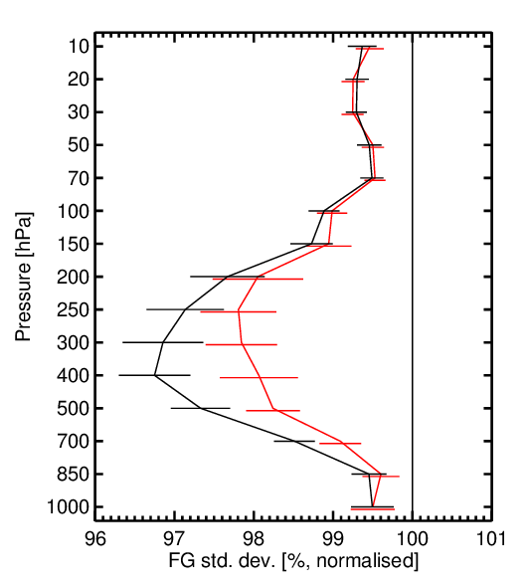
Where the wind tracing information is coming from
Wind, global
Good Bad
IASI: 191 channels from which 10 WV channels
CrIS: 118 channels from which 7 WV channels
AIRS: 136 channels from which 7 WV channels
  CTL (100%): Conventional + AMSU-A
  HyIR: CTL + 2 IASI + CrIS + AIRS
  HyIR without WV channels
Significant amount of wind tracing
comes from the WV channels

Slide 21
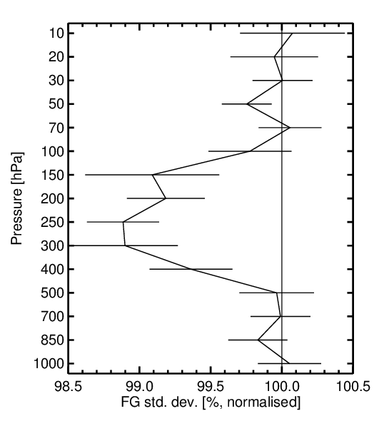
Impact on wind in full observing system experiment
Wind, tropics
Good Bad
Experiment setup
  Cycle 45r1
  1.6-31.8.2017
CTL (100%): Full observing system, IASI as in operations
EXP: Full observing system, IASI with additional WV channels and updated R
Adding more WV channels increases
the wind tracing

Slide 22
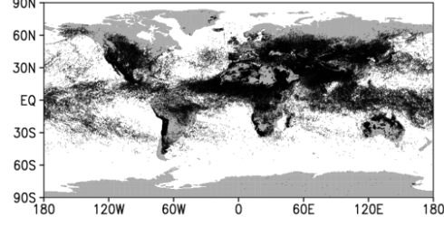
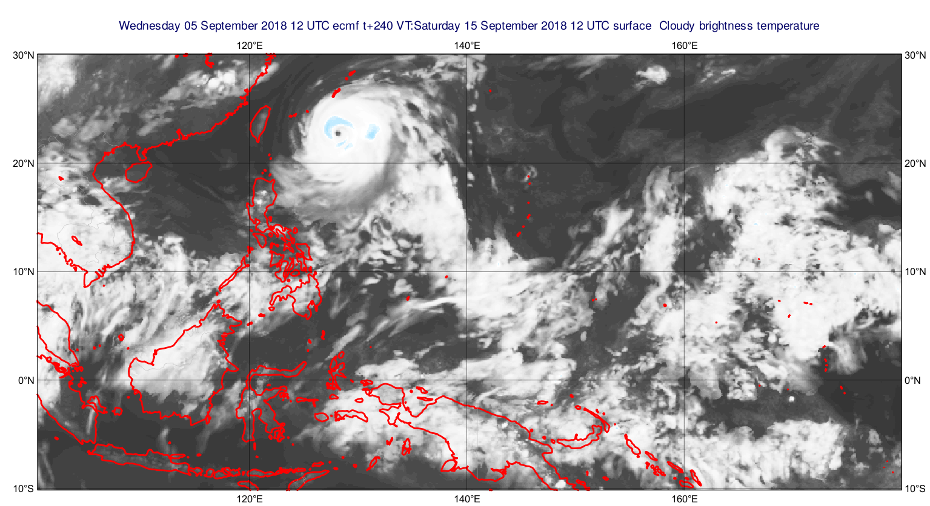
Making better use of IR in cloudy scenes
Aerosol contamination rejections for IASi
Continue to improve detection of clouds and aerosols
Using IR channels (high peaking) weakly affected by clouds in all-sky
Using strongly affected window channels to provide cloud information complimentary to that provided by MW
IR (10 micron) view of Super Typhoon Mangkhut

Slide 23
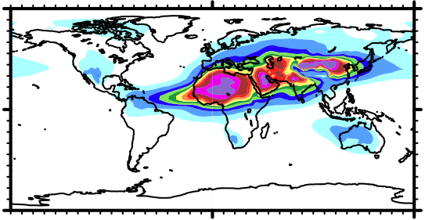
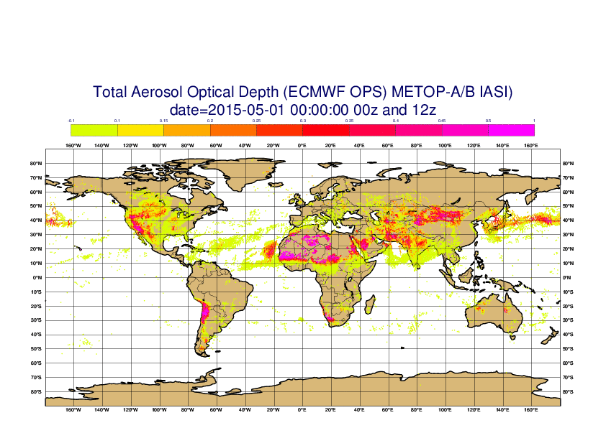
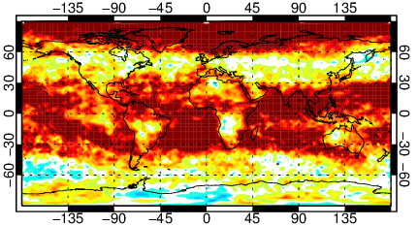
Improve NWP forecasts by exploiting IR atmospheric composition information (for FC radiation calculations)
Atmospheric composition from hyperspectral IR L1 radiances (notably ozone and aerosols) are a valuable source of real-time information that should be exploited to improve the accuracy of the NWP forecast radiation calculations (and stop using climatology! )
CAMS May climatology (used in operations)
Impact of ozone information from hyperspectral IR

Slide 24
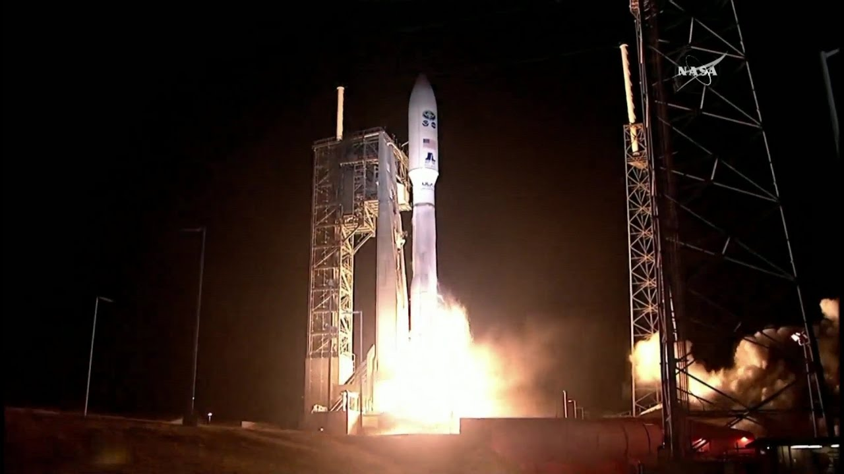
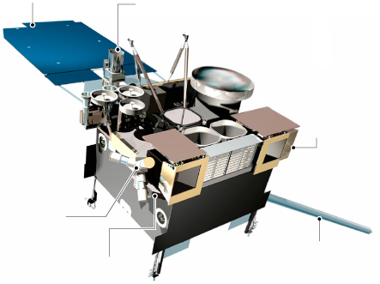
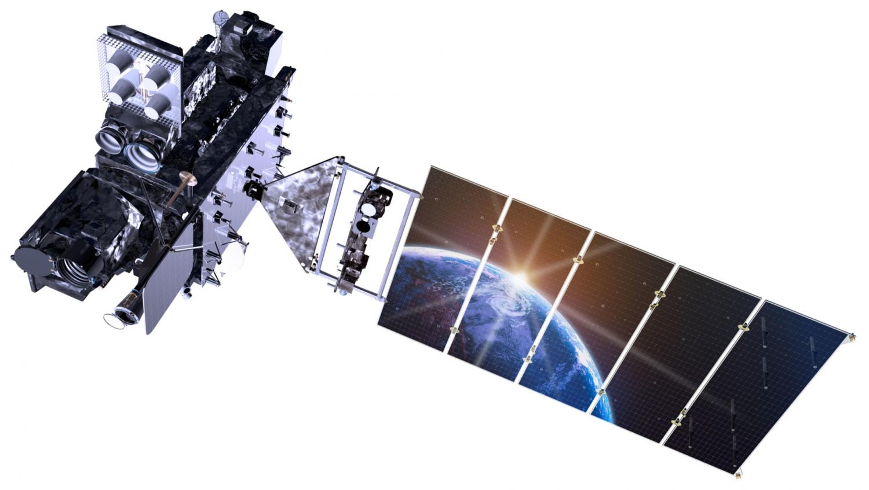
Transition from GOES-13 to GOES-16 (GOES-EAST)
2016
2017
2018
2019
2020
GOES-R launched
Nov 2016
GOES-13 retired
Jan 2018
GOES-16 CSR officially available May 2019 (!)
The official GOES-16 CSR product will be available in May 2019.
NOAA/NESDIS/STAR have provided an unofficial stream via ftp.

Slide 25
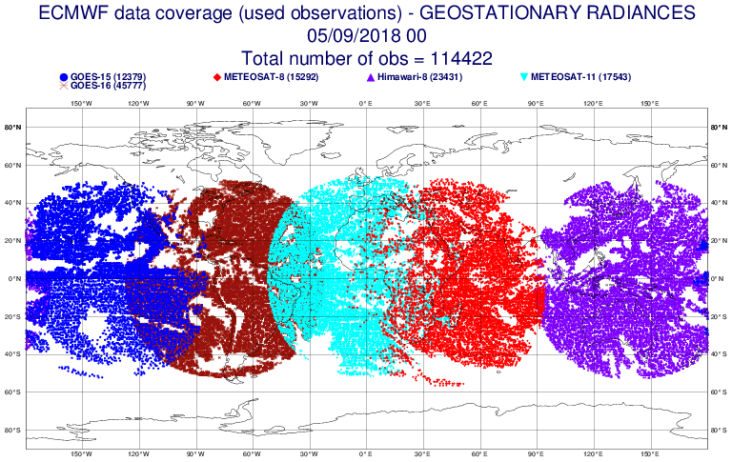
GOES-16 Clear Sky Radiance assimilation radiances
Operational assimilation began on July 26th 2018

Slide 26
Microwave Radiances and AMVs
New observations:
  Operational assimilation of:
    Met-11 and GOES-16 AMVs → 13 satellites/satellite combinations in operations
    ATMS from NOAA-20 → 19 MW instruments in operations
  First glimpse at data from FY-3D
All-sky developments:
  Significant MW imager upgrade
  Radiative transfer
  Progress with IR and AMSU-A in all-sky
  Correlated observation errors (MW imagers, IR all-sky)
Treatment of biases and uncertainties:
  Correlated observation errors for S-NPP ATMS

Slide 27
Overview of AMV activities
Meteosat-11 replaced Meteosat-10 (20th Feb 2018)
Introduction of GOES-16
  Data routinely received 15th Dec 2017
  Loss of GOES-13 on 2nd Jan 2018
  Monitoring 17th April 2018
  Activation 22nd May 2018
Ongoing: investigating low level height assignment using model profiles

Slide 28
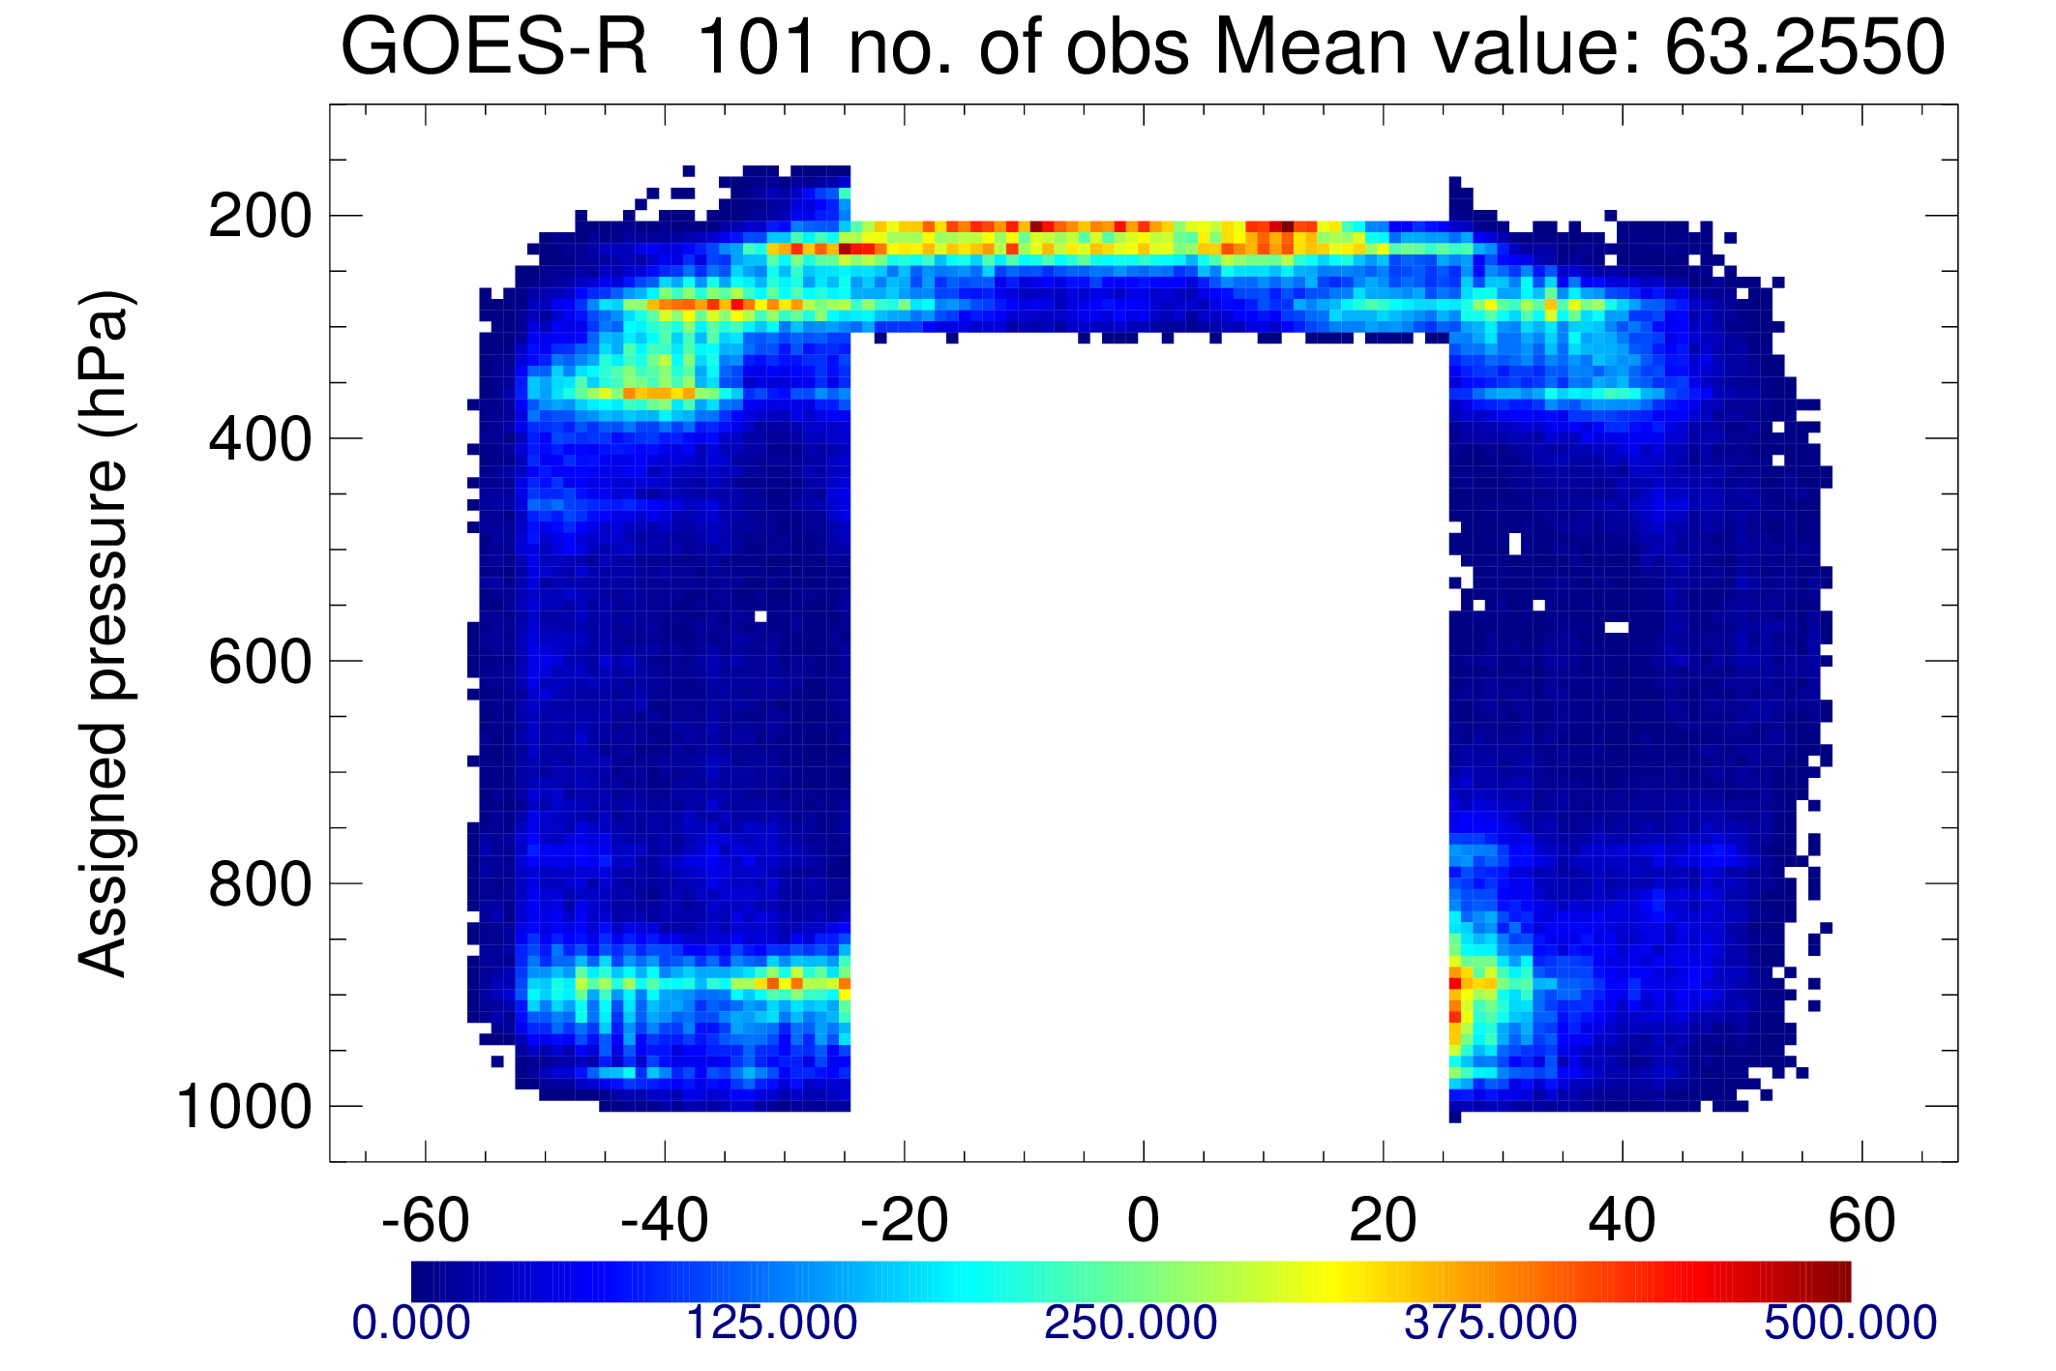
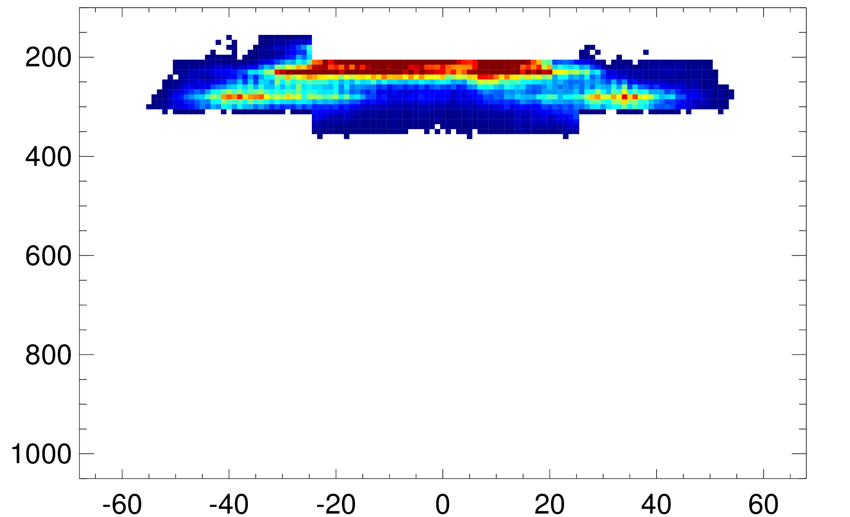
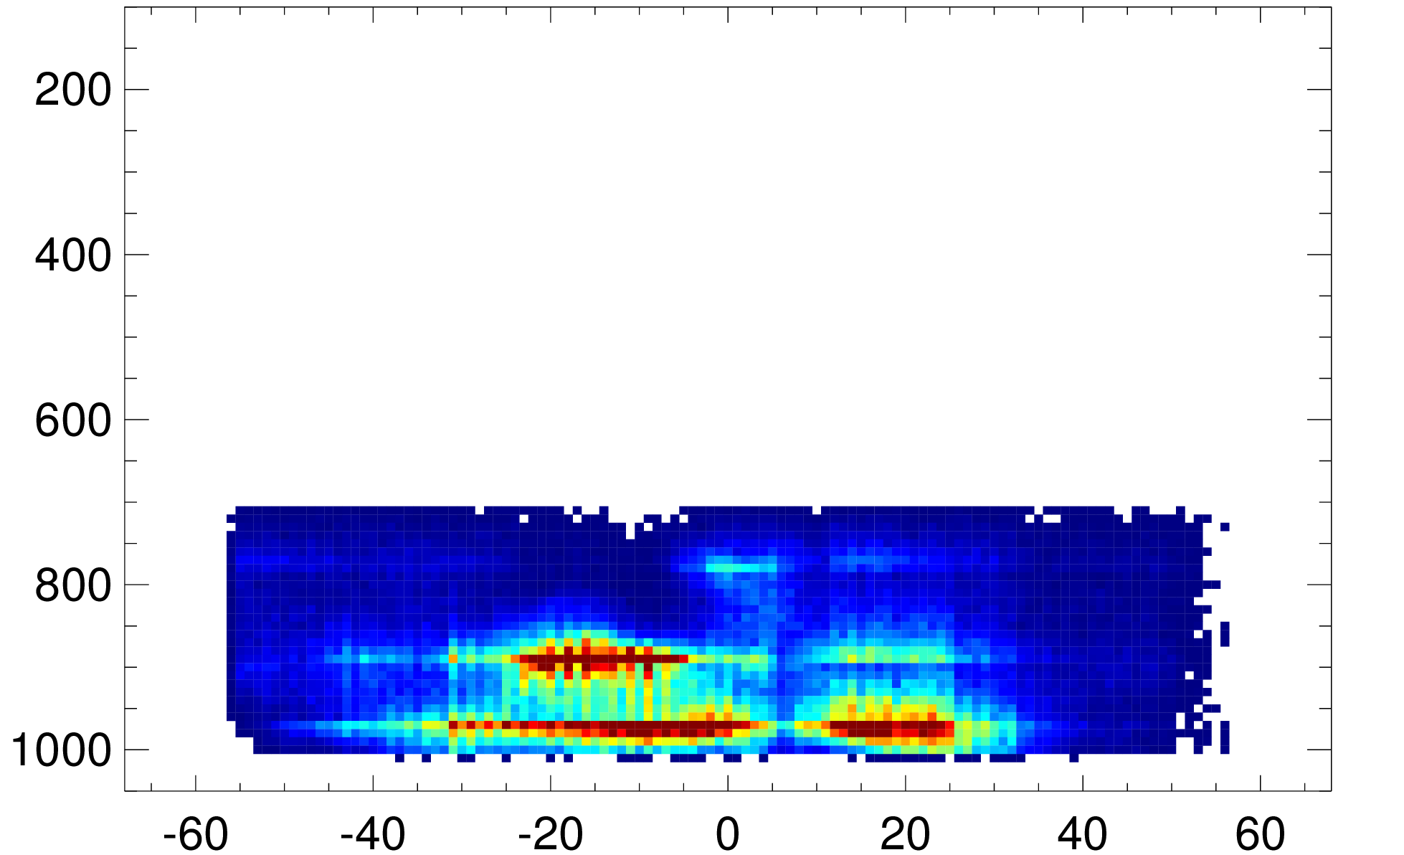
GOES-16 AMV assimilation experiments
Control: full observing system except AMVs in GOES-E position
Initial attempt with bolder use of data showed negative impacts esp. high level tropics
Tropics traditionally difficult area
Restricting tropics above 200hPa removes negative signal
Active GOES-16 AMVs
Vis
IR
WV
Number of AMVs

Slide 29
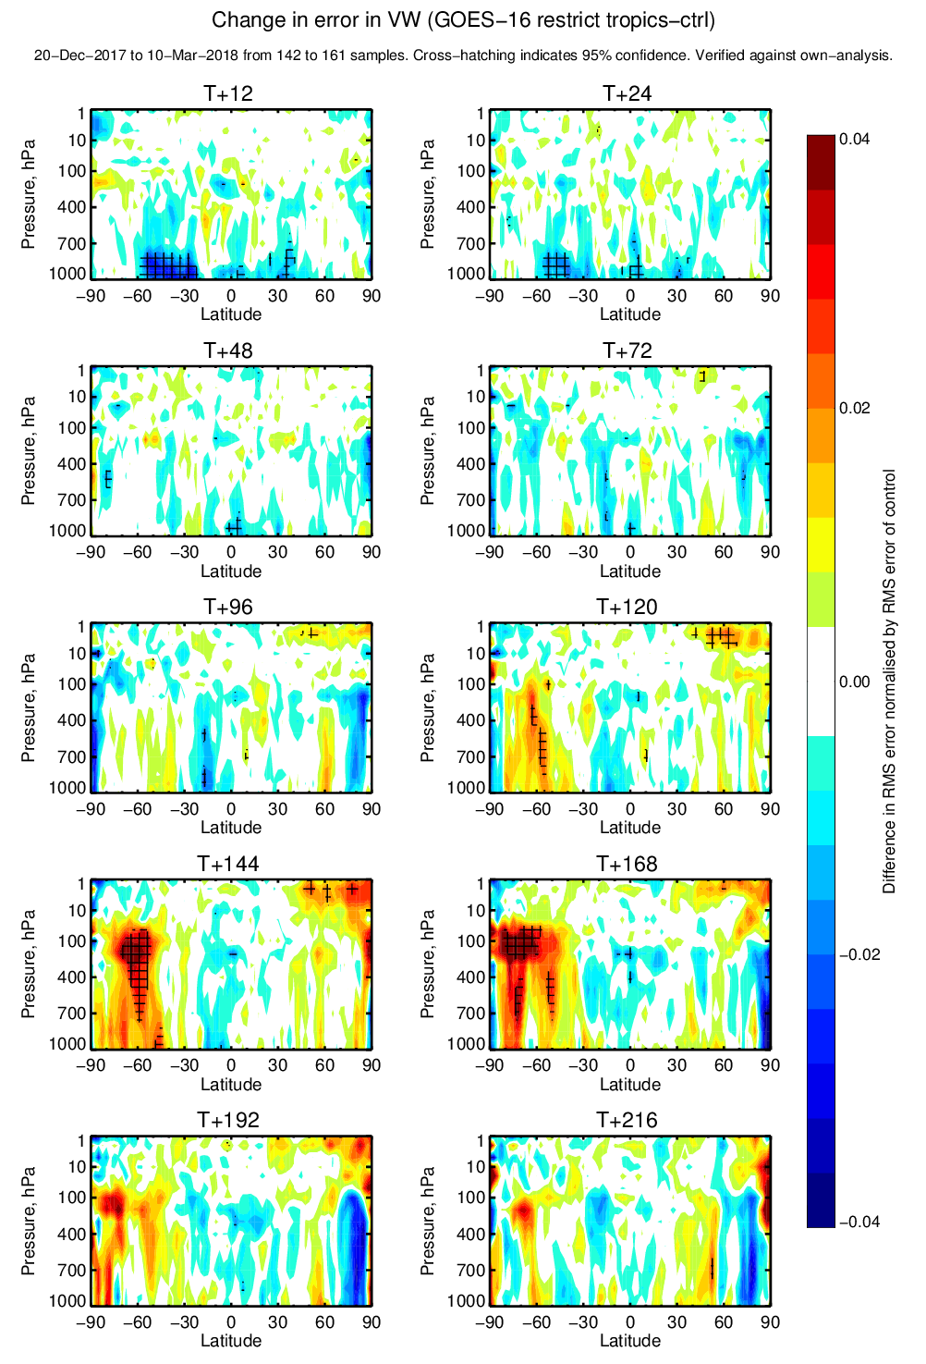
GOES-16 AMVs: Positive impacts in SH and low levels
Degradation
0.04
Change in vector wind error
0.02
Difference in RMS error normalised by RMS error of control
0.00
-0.02
-0.04
Improvement

Slide 30
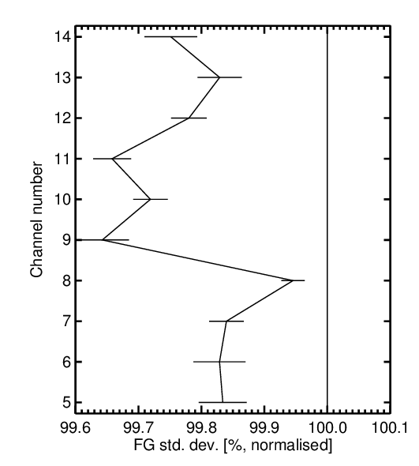
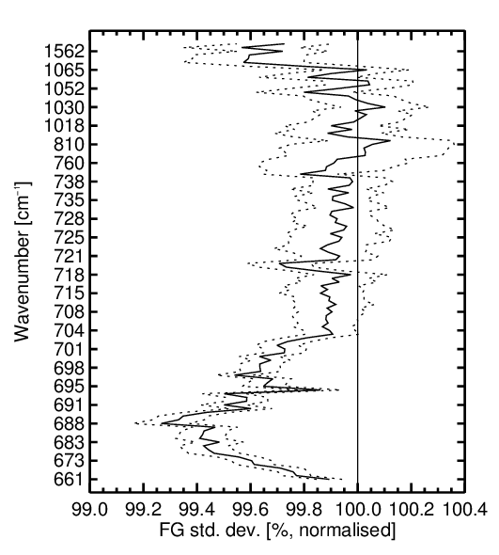
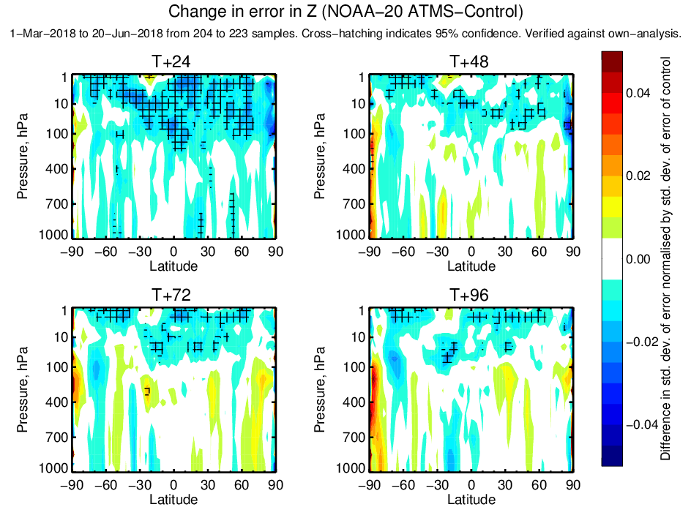
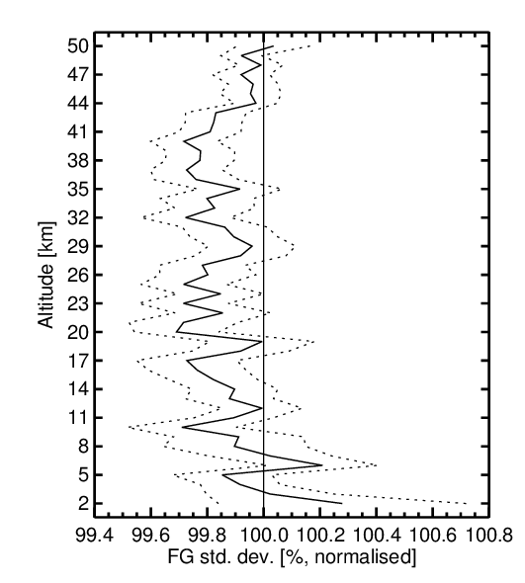
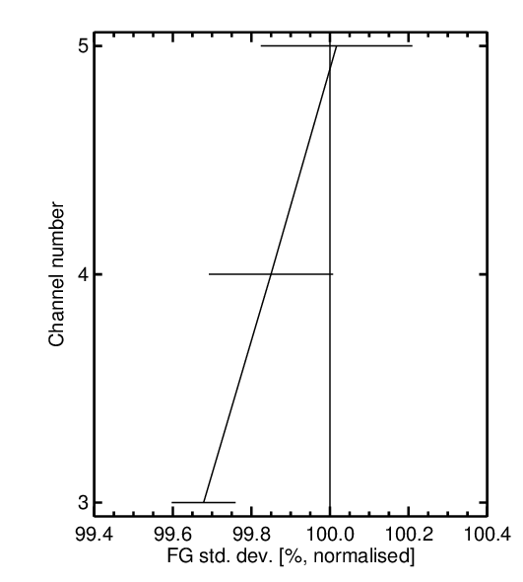
Assimilation experiment results –
From three and half months
NOAA-20 ATMS
AMSU-A
CrIS
Improved first guess fits to:
  Temperature observations (AMSU-A, CrIS, GPSRO)
  Humidity observations (MHS, GEO CSRs)
Neutral to slightly positive forecast scores:
  Improved geopotential height forecasts, particularly in the stratosphere
NOAA-20 ATMS assimilation switched on in operations from 22nd May 2018
Better
Worse
Better
Worse
Change in RMSE of geopotential height forecasts
GPSRO
MHS
Worse
Better
Better
Worse
Better
Worse

Slide 31
All-sky and all-surface radiance assimilation
Planned additions to next IFS cycle (March 2019):
  Good lower tropospheric impact from 150 and 166 GHz channels
Observation error covariances for all-sky assimilation:
  Necessary to allow all-sky IR to have a decent impact
  All-sky imagers with error covariances: ~1% benefits to forecast scores

Slide 32
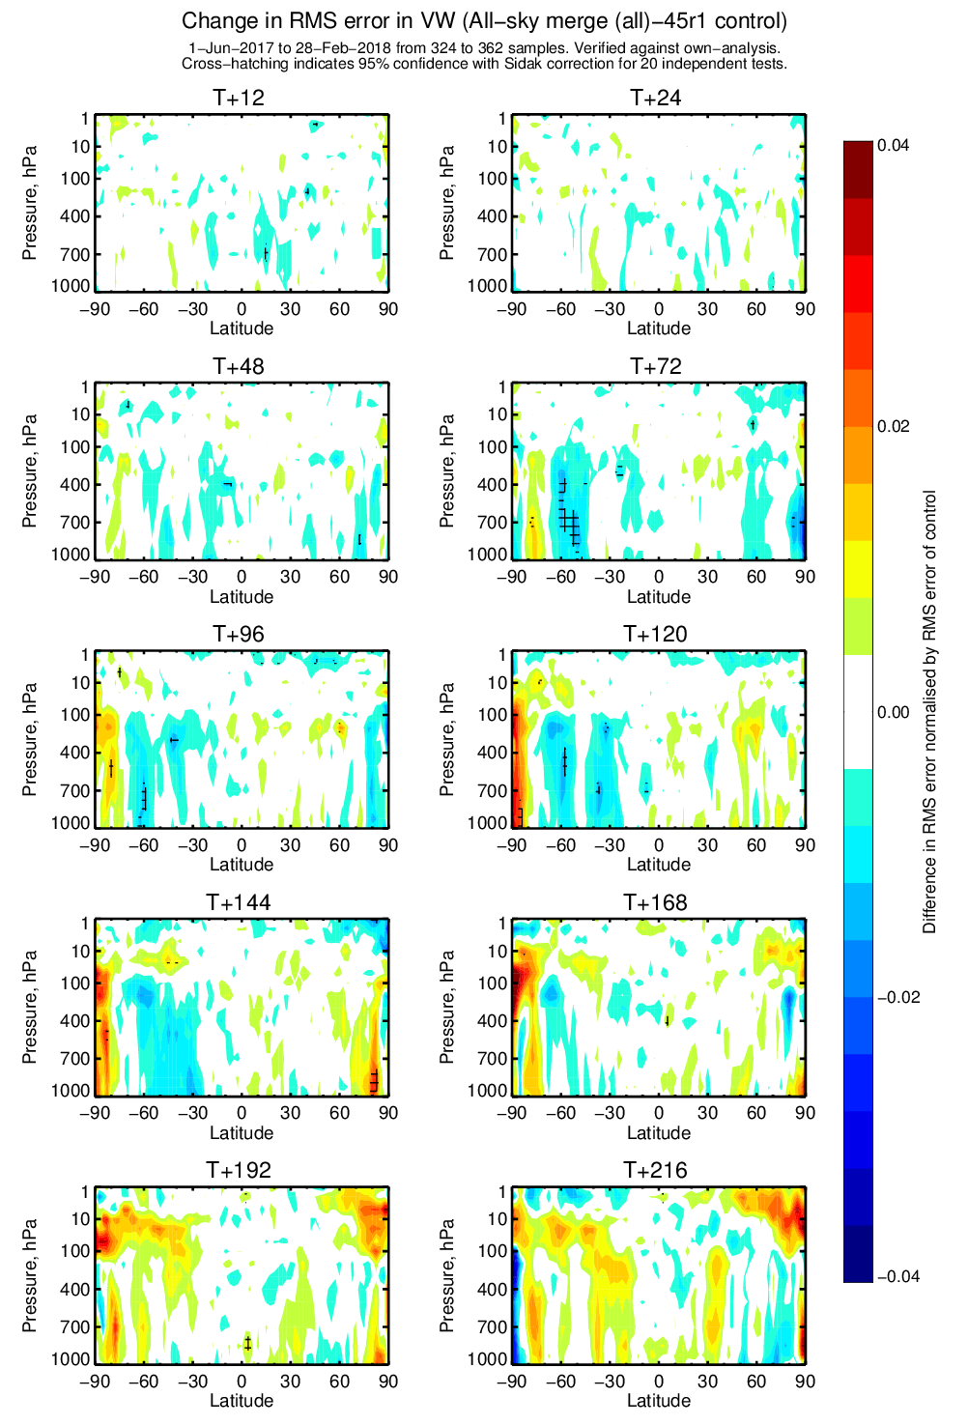
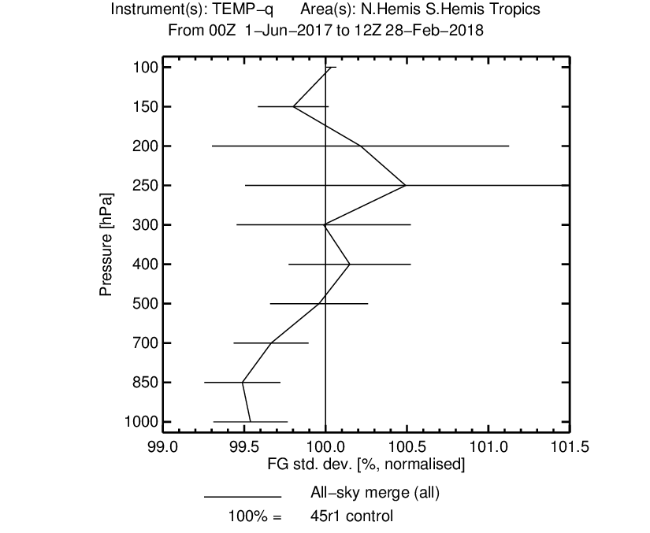
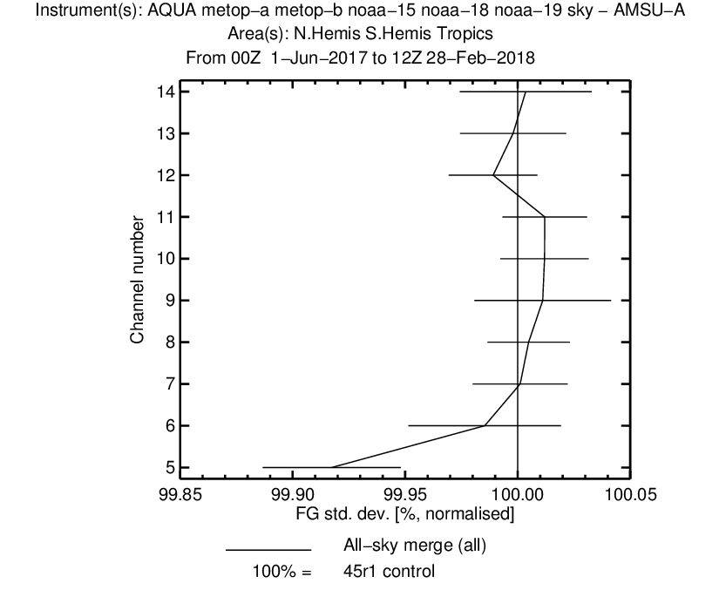
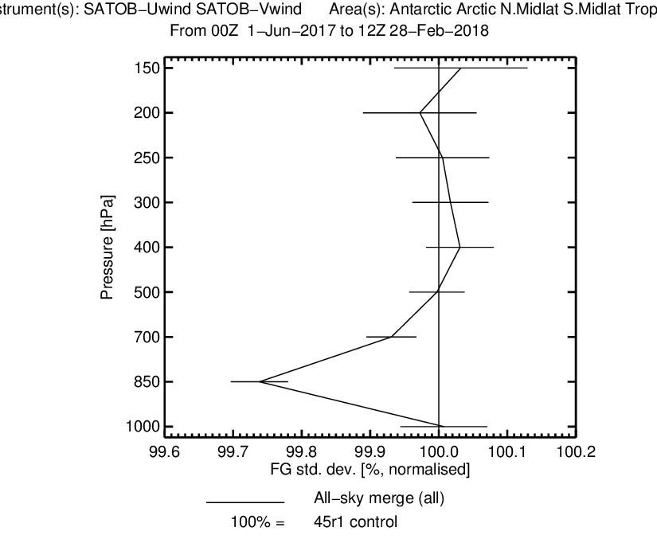
All-sky assimilation: Impact of 150 GHz and 166 GHz channels
Lower-tropospheric moisture, temperature, winds improved at FG
Medium-range wind forecasts improved in SH

Slide 33
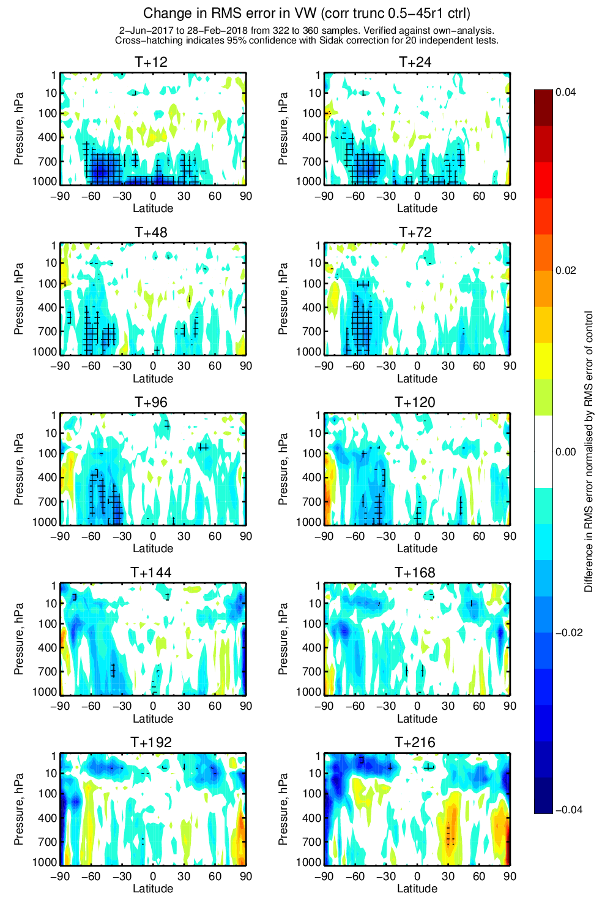
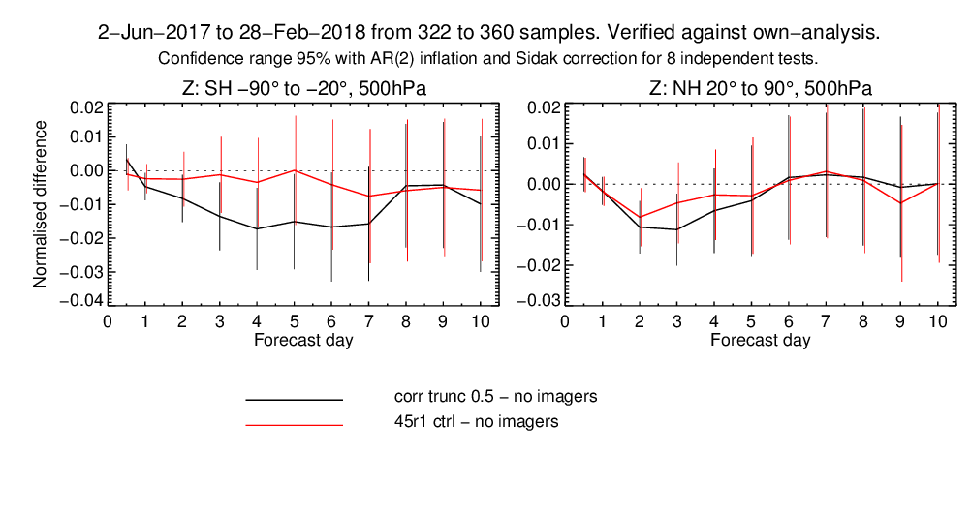
All-sky microwave error covariance
Essential to good results:
  VarQC
  Eigenvalue truncation at 0.5
Results: all-sky microwave imager impact increased, particularly at 500hPa and below
Impact of implementing observation error covariances for GMI, AMSR2, SSMIS F17 (versus 45r1 control)
Total impact of microwave imagers versus no imager control
Without covariances (45r1)
With covariances

Slide 34
Near future in situ observation related work
Surface data: assimilation of T2m, RH2m (night), uv10m from land stations
Test impact of HiRes dropsonde data on TCs
Further work on radiosonde descent data
Operational aspects including migration to BUFR and WIGOS identifiers
Further ahead: MODE-S aircraft data?

Slide 35

Radiosonde descent data
Germany, Finland and UK are producing descent data
Have been processed in expts for January and June 2018
Encouraging O-B statistics (red – descent)
  But warm bias at upper levels (worse without parachute – Finland)
  Wind rms(O-B) smaller?? Descent oversmoothed or ascent undersmoothed? (Filtered to remove pendulum motion.)
Future
  Use new BUFR sequence
  Re-evaluate new, lighter RS41
  Specific rejections, processing?
  Assimilation tests

Slide 36
Actively Sensed Observations plans
Use of scatterometer data in coupled atmosphere-ocean data assimation
Monitor Aeolus DWL winds in operational suite, and assimilate if quality is OK
Assimilation of Sentinel-3B altimeter significant wave height, investigate assimilation of Sentinel-1 wave mode data
Evaluate and implement GPS-RO data from Metop-C
Introduce the many new scatterometer datasets available soon:
SCATSAT-1 (complete the assessment)
CFOSAT: 29 October 2018
Metop-C: 6 November 2018
HY-2B: November 2018
Oceansat-3: January 2019

Slide 37


Impact of ASCAT on a coupled system (CERA-SAT)
Impact on Ocean Salinity
Jan-Dec 2014
SCATT versus No SCATT

Slide 38


Aeolus Doppler wind Lidar mission status
Thanks to ESA, Arianespace and the Aeolus team for Aeolus photos
Aeolus was launched on 22 August 2018
1st Doppler wind lidar in space
Now in Commissioning Phase

Slide 39


Aeolus Doppler wind Lidar mission status
Real observations, both Rayleigh and Mie HLOS winds
Digital elevation model
From Mike Rennie

Slide 40

What can we say today about Aeolus?
Aeolus Doppler wind Lidar mission status
Timeline
22 August 2018: successful launch
2 September 2018: Laser switched on
3 September 2018: first Level-2 wind product generated!
In Orbit Commissioning Review coming up very soon.
Status
Measurement bias: currently found to be low and within the mission requirements.
Random errors: mission requirements are not yet met, but that ECMWF consider the quality sufficient to start first impact studies exploiting the current data quality
Timeliness: currently 2.0 hours to get Level-1 to ECMWF, L1 to L2 takes just 8 minutes.
ECMWF
Key role for ECMWF in Aeolus operational ground segment, generating Level-2 wind products and using NWP as a tool to establish the data quality early on in the mission.
Looks encouraging at this early stage!
Goal is to assimilate operationally within 1 year of launch!

Slide 41
Previous Nature Run (2007)
Spectral resolution : TL511 (39km) , 91 levels, 3 hourly archiving
Period: May 1, 2005 to June 1,2006. Daily SST and ICE
New Nature Run (2018)
Spectral resolution : TCo1279 (9km), 137 levels, 3 hourly archiving
Period: September 29, 2015 to December 1, 2016. Daily SST and ICE.
Two months of the period with 1 hourly archiving
Main contributors at ECMWF: Sylvie Malardel, Pedro Maciel, Nils W. and Lars I.
A new ECMWF nature run (ECO1280) is being made at the moment
Plan and status:
Ross Hoffman is our NOAA contact person
Nature run is being performed on ECMWF’s HPC
Data volumes very large: 100-125 TBytes
Data in the process of being transferred to USA from ECMWF
Data will be freely available for non-commercial applications
CIRA (USA) should have a complete copy by end of November 2018.
NOAA staff will present ECO1280 at AMS and AGU.
CIRA could be open for business with beta users now.

Slide 42
Advice to Meteo-France regarding value of French Polynesian radiosondes
Meteo-France is planning to reduce the number of French Polynesian radiosonde stations from four to one
Reason: To save money – more expensive to launch than from mainland France
ECMWF got a request from Meteo-France RD staff to provide support for keeping these remote stations alive.
ECMWF computed total FSOI statistics for each of the four French Polynesian radiosonde stations, and compared it against a mainland France launch
Decision by Meteo France will be taken 1H 2019

Slide 43

FSOI impact per radiosonde sounding compared to mainland France impact

Slide 44
Summary
ECMWF still making progress in NWP, primarily through:
  improved use of observations in the data assimilation system.
  Improved data assimilation methods
  Improved forecast model
There are still issues with observation, as there always will be.
Collaborations like GODEX are very beneficial for the NWP community.
Part 2 of ECMWF status report later this afternoon:
BUFR migration, timeliness and snow data issues – Ioannis Mallas

Slide 45

Thank you for your attention!

